Slide 1
CSCI 526 Database Systems Project FOOD DELIVERY SERVICE
Professor: Dr. Mutlu Mete
Team Names:
Srivinusha Janga(50267673)
Lakshmi Chinnam (50263055)
Purushotam Pradeep Kumar Reddy Desireddy (50256934)

Slide 2
What is Food Delivery System ?
Each Delivery_Service have sheer number of Restaurants offered.Adding delivery service to the restaurant will help you distinguish yourself from the competition,and it also attract Customers
It should have a good Food Delivery Staff(Employee) ,Delivery drivers have a their own vehicle(Emp_vehicle),Each Delivery person will be managed by the manager.Each employee will be trained on the best way to place the food in their cars so no spills occur and how to speak to the customer when they deliver the food.
Each Restaurant have Menu,Feedback to improve more from Customer, Restaurant should accept the Feedback from Customer and do reply.
Menu should contain detailed information Ingredients and Nutrition_fact.

Slide 3
Customers will place the orders and Restaurant Expose Customers by giving many offers and allowing customer to pay bill in different Pay_types.
Nowadays people are faced with a situation within which they are doing not
have time to cook or prepare food.
Access to a good sort of foods one among the foremost important advantages that these services provide is that the people may order from an oversized menu.
These days a spread of local eateries and national restaurants participate in online food ordering by partnering with delivery companies like Uber Eats, Postmates, Grubhub .
These services allow customers to pursue a bigger selection of foods and restaurants and order food through a convenient online page or app.having it delivered to their exterior door, is helping these people get their work done typically seniors

Slide 4
Entities
Delivery_Service
Restaurant
Feedback
Employee
Customer
Menu
Delivery_Vehicle
Order_List
Booking
Offer
Payment
Emp_Delivery
Nutrition_Fact

Slide 5
ER-Diagram

Slide 6
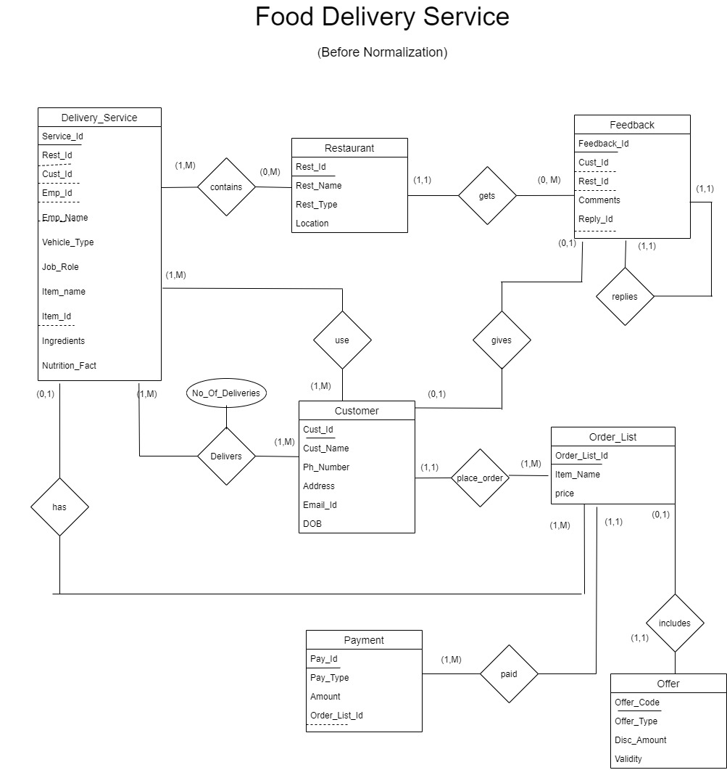

Slide 7
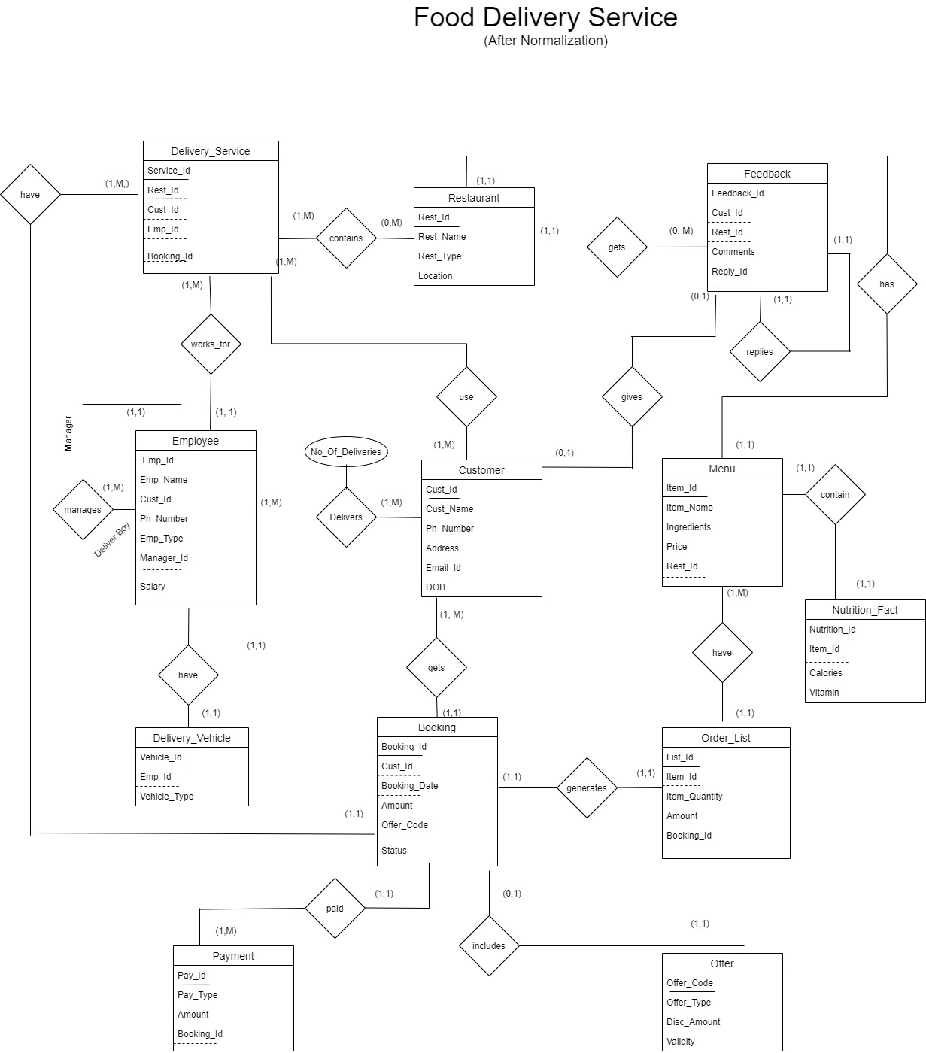

Slide 8
Referential Integrity

Slide 9
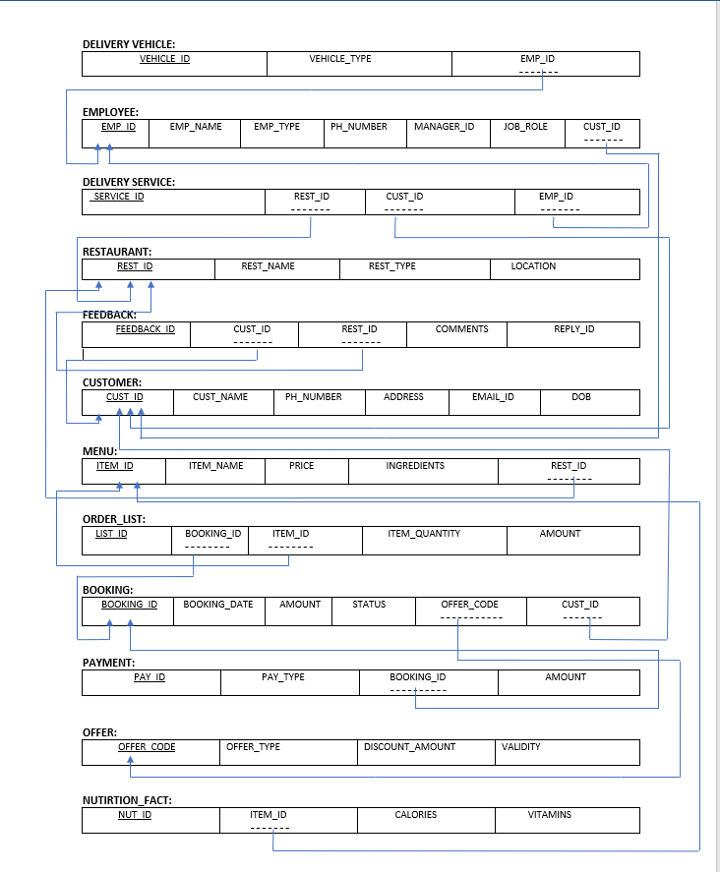

Slide 10
CREATE TABLES

Slide 11
/*CUSTOMER*/
CREATE TABLE MYPROJECT.CUSTOMER(
CUST_ID INT NOT NULL,
CUST_NAME VARCHAR2(30) NOT NULL,
PH_NUMBER INT NOT NULL,
ADDRESS VARCHAR2(50),
EMAIL_ID VARCHAR2(50),
DOB DATE,
CONSTRAINT CUST_ID_PK PRIMARY KEY(CUST_ID)
);
/*DELIVERY_VEHICLE*/
CREATE TABLE MYPROJECT.DELIVERY_VEHICLE(
VEHICLE_ID INT NOT NULL,
VEHICLE_TYPE VARCHAR2(30),
EMP_ID INT,
CONSTRAINT VEHICLE_ID_PK PRIMARY KEY(VEHICLE_ID),
CONSTRAINT EMP_ID_FK FOREIGN KEY(EMP_ID) REFERENCES MYPROJECT.EMPLOYEE(EMP_ID) ON DELETE SET NULL
);

Slide 12
/*BOOKING_QUERIES*/
CREATE TABLE MYPROJECT.BOOKING(
BOOKING_ID INT,
AMOUNT FLOAT,
BOOKING_DATE DATE,
CUST_ID INT,
OFFER_CODE VARCHAR2(30),
STATUS VARCHAR2(50),
CONSTRAINT BOOKING_BOOKING_ID PRIMARY KEY(BOOKING_ID),
CONSTRAINT BOOKING_CUST_ID_FK FOREIGN KEY(CUST_ID) REFERENCES MYPROJECT.CUSTOMER(CUST_ID) ON DELETE SET NULL,
CONSTRAINT BOOKING_OFFER_CODE_FK FOREIGN KEY(OFFER_CODE) REFERENCES MYPROJECT.OFFER(OFFER_CODE) ON DELETE SET NULL
);

Slide 13
/*PAYMENT_QUERIES*/
CREATE TABLE MYPROJECT. PAYMENT(
PAY_ID INT,
PAY_TYPE VARCHAR2(30),
AMOUNT FLOAT,
BOOKING_ID INT,
CONSTRAINT PAY_ID PRIMARY KEY(PAY_ID),
CONSTRAINT PAYMENT_BOOKING_ID_FK FOREIGN KEY(BOOKING_ID) REFERENCES MYPROJECT.BOOKING(BOOKING_ID) ON DELETE SET NULL
);
/*EMP_DELIVERY*/
CREATE TABLE MYPROJECT. EMP_DELIVERY(
EMP_ID INT,
SERVICE_ID INT,
DELIVERIES NUMBER,
CONSTRAINT DELIVERIES_PK PRIMARY KEY(EMP_ID,SERVICE_ID),
CONSTRAINT DELIVERIES_SERVICE_FK FOREIGN KEY(SERVICE_ID) REFERENCES DELIVERY_SERVICE(SERVICE_ID),
CONSTRAINT DELIVERIES_EMPLOYEE_FK FOREIGN KEY (EMP_ID) REFERENCES EMPLOYEE(EMP_ID)
);

Slide 14
/*FEEDBACK*/
CREATE TABLE MYPROJECT.FEEDBACK(
FEEDBACK_ID INT NOT NULL,
COMMENTS VARCHAR2(50),
CUST_ID INT,
REST_ID INT,
REPLY_ID INT,
CONSTRAINT FEEDBACK_ID PRIMARY KEY(FEEDBACK_ID),
CONSTRAINT FEEDBACK_CUST_ID_FK FOREIGN KEY(CUST_ID) REFERENCES MYPROJECT.CUSTOMER(CUST_ID) ON DELETE CASCADE,
CONSTRAINT FEEDBACK_REST_ID_FK FOREIGN KEY(REST_ID) REFERENCES MYPROJECT.RESTAURANT(REST_ID) ON DELETE CASCADE,
CONSTRAINT FEEDBACK_REP_ID_FK FOREIGN KEY(REPLY_ID) REFERENCES MYPROJECT.FEEDBACK(FEEDBACK_ID) ON DELETE CASCADE
);

Slide 15
/*ORDER_lIST*/
CREATE TABLE ORDER_lIST(
LIST_ID INT,
ITEM_QUANTITY INT,
AMOUNT FLOAT,
ITEM_ID INT,
BOOKING_ID INT,
CONSTRAINT LIST_ID PRIMARY KEY(LIST_ID),
CONSTRAINT ORDER_ID_FK FOREIGN KEY(ITEM_ID) REFERENCES MYPROJECT.MENU(ITEM_ID),
CONSTRAINT ORDERS_ID_FK FOREIGN KEY(BOOKING_ID) REFERENCES MYPROJECT.BOOKING(BOOKING_ID) ON DELETE CASCADE
);
/*OFFER*/
CREATE TABLE MYPROJECT. OFFER(
OFFER_CODE VARCHAR2(30) NOT NULL,
OFFER_TYPE VARCHAR2(30),
DISC_AMOUNT FLOAT,
VALIDITY DATE NOT NULL,
CONSTRAINT OFFER_CODE PRIMARY KEY(OFFER_CODE)
);

Slide 16
/*MENU*/
CREATE TABLE MYPROJECT.MENU(
ITEM_ID INT NOT NULL,
ITEM_NAME VARCHAR2(100),
PRICE FLOAT,
REST_ID INT,
INGREDIENTS VARCHAR2(256),
CONSTRAINT ITEM_ID PRIMARY KEY(ITEM_ID),
CONSTRAINT REST_ID_FK FOREIGN KEY(REST_ID) REFERENCES MYPROJECT.RESTAURANT(REST_ID) ON DELETE SET NULL
);
/*NUTRITION_FACT*/
CREATE TABLE NUTRITION_FACT(
NF_ID INT,
ITEM_ID INT,
CALORIES INT,
VITAMIN CHAR,
CONSTRAINT NF_ID PRIMARY KEY(NF_ID),
CONSTRAINT NF_ID_FK FOREIGN KEY(ITEM_ID) REFERENCES MYPROJECT.MENU(ITEM_ID)
);

Slide 17
/*RESTAURANT*/
CREATE TABLE MYPROJECT.RESTAURANT(
REST_ID INT NOT NULL,
REST_NAME VARCHAR2(30) NOT NULL,
REST_TYPE VARCHAR2(30),
LOCATION VARCHAR2(30) NOT NULL,
CONSTRAINT REST_ID PRIMARY KEY(REST_ID)
);
/*DELIVERY_SERVICE*/
CREATE TABLE MYPROJECT.DELIVERY_SERVICE(
SERVICE_ID INT NOT NULL,
REST_ID INT NOT NULL,
CUST_ID INT,
EMP_ID INT,
BOOKING_ID INT,
CONSTRAINT SERVICE_ID_PK PRIMARY KEY(SERVICE_ID),
CONSTRAINT REST_ID_FK FOREIGN KEY (REST_ID) REFERENCES MYPROJECT.RESTAURANT(REST_ID),
CONSTRAINT CUST_ID_FK FOREIGN KEY(CUST_ID) REFERENCES MYPROJECT.CUSTOMER(CUST_ID),
CONSTRAINT BOOKING_ID_FK FOREIGN KEY(BOOKING_ID) REFERENCES MYPROJECT.BOOKING(BOOKING_ID)
);

Slide 18
/*EMPLOYEE*/
CREATE TABLE MYPROJECT. EMPLOYEE(
EMP_ID INT NOT NULL,
EMP_NAME VARCHAR2(30) NOT NULL,
PH_NUMBER INT NOT NULL,
JOB_ROLE VARCHAR2(30),
EMP_TYPE VARCHAR2(30),
CUST_ID INT,
MGR_ID INT,
CONSTRAINT EMP_ID_PK PRIMARY KEY(EMP_ID),
CONSTRAINT CUST_ID_FK FOREIGN KEY(CUST_ID) REFERENCES MYPROJECT.CUSTOMER(CUST_ID) ON DELETE SET NULL,
CONSTRAINT MGR_FK FOREIGN KEY(MGR_ID) REFERENCES MYPROJECT.EMPLOYEE(EMP_ID)
);

Slide 19
INSERT DATA

Slide 20
/*EMPLOYEEInsertQuery*/
INSERT INTO EMPLOYEE VALUES(40001,'Samy',9863035870,'Delivery','Full_Time',30004, 40004);
INSERT INTO EMPLOYEE VALUES(40002,'Gary',9708955873,'Manager','Part_Time',30005, 40002);
INSERT INTO EMPLOYEE VALUES(40003,'Tena',4743035872,'Delivery','Part_Time',30006, 40004);
INSERT INTO EMPLOYEE VALUES(40004,'Maina',3263035871,'Manager','Full_Time',30007, NULL);
INSERT INTO EMPLOYEE VALUES(40005,'Dany',4863035709,'manager','Full_Time', 30001,40004);
INSERT INTO EMPLOYEE VALUES(40006,'Josh',3790350232,'Delivery','Part_Time',30001, 40004);
INSERT INTO EMPLOYEE VALUES(40007,'Anil',7863038079,'Delivery','Part_Time',30001, 40001);
/*PAYMENT*/
INSERT INTO PAYMENT VALUES(70001, 'CREDIT', 45, 50004);
INSERT INTO PAYMENT VALUES(70002, 'DEBIT', 40.5, 50005);
INSERT INTO PAYMENT VALUES(70003,'PAYPAL', 60.6, 50001);
INSERT INTO PAYMENT VALUES(70004,'CASH', 70.1, 50002);
INSERT INTO PAYMENT VALUES(70005, 'DEBIT', 90.4 , 50006);
INSERT INTO PAYMENT VALUES(70006, 'CREDIT', 50, 50007);
INSERT INTO PAYMENT VALUES(70007, 'DEBIT', 30.6, 50003);

Slide 21
/*DELIVERY_SERVICEInsertQuery*/
INSERT INTO DELIVERY_SERVICE VALUES(10001, 'FOODIES GROUP', 20001, 30001, 50001,40001);
INSERT INTO DELIVERY_SERVICE VALUES(10002, 'FOODIES GROUP', 20002, 30002, 50002,40002);
INSERT INTO DELIVERY_SERVICE VALUES(10003, 'FOODIES GROUP', 20003, 30003, 50003,40003);
INSERT INTO DELIVERY_SERVICE VALUES(10004, 'FOODIES GROUP', 20004, 30004, 50004,40004);
INSERT INTO DELIVERY_SERVICE VALUES(10005, 'FOODIES GROUP', 20005, 30005, 50005,40005);
INSERT INTO DELIVERY_SERVICE VALUES(10006, 'FOODIES GROUP', 20006, 30006, 50006,40006);
INSERT INTO DELIVERY_SERVICE VALUES(10007, 'FOODIES GROUP', 20007, 30007, 50007,40007);
/*RESTAURANTInsertQuery*/
INSERT INTO RESTAURANT VALUES(20001, 'Yummy Kitchen', 'Ethnic', '251 IUA Dallas',null);
INSERT INTO RESTAURANT VALUES(20002, 'Green Chilly', 'Osteria', '012 HUH Plano',null);
INSERT INTO RESTAURANT VALUES(20003, 'Big Balls', 'Dine casual', '311 FAM Irving',null);
INSERT INTO RESTAURANT VALUES(20004, 'Manis BBQ', 'Fast Food', '872 FGC Commerce',null);
INSERT INTO RESTAURANT VALUES(20005, 'Coca Foods', 'Coffee hub', '280 MNC Houston',null);
INSERT INTO RESTAURANT VALUES(20006, 'Burrito', 'Pizza', '471 GreenVille',null);
INSERT INTO RESTAURANT VALUES(20007, 'Wild Dine', 'Dark', '547 Garland',null);

Slide 22
/*BOOKINGInsertQuery*/
INSERT INTO BOOKING VALUES(50001,4.5,30002, 'FOODDAY12893','BOOKING CONFIRMED','27 MARCH 2020');
INSERT INTO BOOKING VALUES(50002,5.5,30005, 'JSMSXZ009','BOOKING CONFIRMED','14 FEB 2020');
INSERT INTO BOOKING VALUES(50003,6, 30007, '',' BOOKING FAILED','07 JAN 2020');
INSERT INTO BOOKING VALUES(50004,7, 30004, 'YUMMYIES0033','','18 JULY 2020');
INSERT INTO BOOKING VALUES(50005,7, 30005, '','CANCELLED','19 AUG 2020');
INSERT INTO BOOKING VALUES(50006,3.5,30006, 'JACCOKE1234','BOOKING FAILED','15 SEP 2020');
INSERT INTO BOOKING VALUES(50007,10,30007, '','CANCELLED','27 OCT 2020');
INSERT INTO BOOKING VALUES(50008,10,30007, '','CANCELLED','07 APRIL 2020’);
/*OFFERInsertQuery*/
INSERT INTO OFFER VALUES('FOODDAY12893','Happy_Hour', 2.5, '07 mar 2020');
INSERT INTO OFFER VALUES('JSMSXZ009','Seasonal', 26.5, '07 may 2020');
INSERT INTO OFFER VALUES('YUMMYIES0033', 'Senior citizen discount', 50, '01 jun 2020');
INSERT INTO OFFER VALUES('JACCOKE1234', 'Trail Offer', 5, '30 apr 2020');
INSERT INTO OFFER VALUES('HAPPY10000', 'FREE DELIVERY', 5, '30 JUN 2020');

Slide 23
/*MENUInsertQuery*/
INSERT INTO MENU VALUES(80001, 'Becon', 3.5, 20001);
INSERT INTO MENU VALUES(80002, 'Chicken Roast', 3.5, 20001);
INSERT INTO MENU VALUES(80003, 'Chicken Wings', 3.5, 20001);
INSERT INTO MENU VALUES(80004, 'Mutton Balls', 3.5, 20001);
INSERT INTO MENU VALUES(80005, 'Chicken Pizza', 3.5, 20002);
INSERT INTO MENU VALUES(80006, 'Veg Pizza', 3.5, 20002);
INSERT INTO MENU VALUES(80007, 'Mutton Pizza', 4, 20002);
INSERT INTO MENU VALUES(80008, 'Mushroom Pizza', 3.5, 20003);
INSERT INTO MENU VALUES(80009, 'Mushroom Dry', 3.5, 20003);
INSERT INTO MENU VALUES(80010, 'Chicken Pepper Fry', 4, 20003);
INSERT INTO MENU VALUES(80011, 'BBQ Chicken', 5, 20004);
INSERT INTO MENU VALUES(80012, 'Biriyani ', 8, 20004);
INSERT INTO MENU VALUES(80013, 'Dosa', 4, 20004);
INSERT INTO MENU VALUES(80014, 'Meat Sauce', 4, 20004);
INSERT INTO MENU VALUES(80015, 'Veg Palav', 4, 20004);
INSERT INTO MENU VALUES(80016, 'Jeera Rice', 4, 20004);

Slide 24
/*DELIVERY_VEHICLEInsertQuery*/
INSERT INTO DELIVERY_VEHICLE VALUES(60001, 'Bike' ,40001);
INSERT INTO DELIVERY_VEHICLE VALUES(60002, 'Car' ,40003);
INSERT INTO DELIVERY_VEHICLE VALUES(60003, 'Car' ,40002);
INSERT INTO DELIVERY_VEHICLE VALUES(60004, 'Truck' ,40006);
INSERT INTO DELIVERY_VEHICLE VALUES(60005, 'Bike' ,40007);
INSERT INTO DELIVERY_VEHICLE VALUES(60006, 'Truck' ,40004);
INSERT INTO DELIVERY_VEHICLE VALUES(60007, 'Car' ,40005);
/*FEEDBACKInsertQuery*/
INSERT INTO FEEDBACK VALUES(90001, 'Good Quality', 30001, 20001,90001);
INSERT INTO FEEDBACK VALUES(90002, 'wonderful meal', 30003, 20002,90007);
INSERT INTO FEEDBACK VALUES(90003, 'Loves Food',30006, 20002,90006);
INSERT INTO FEEDBACK VALUES(90004, 'Not Tastey', 30002, 20004,90005);
INSERT INTO FEEDBACK VALUES(90005, 'Fresh Food', 30003, 20004,90003);
INSERT INTO FEEDBACK VALUES(90006, 'it was delicious.', 30004, 20003,90002);
INSERT INTO FEEDBACK VALUES(90007, 'Ambience is good', 30005, 20006,90001);

Slide 25
/*ORDER_lISTInsertQuery*/
INSERT INTO ORDER_lIST VALUES(200,4,30,80010 ,50004);
INSERT INTO ORDER_lIST VALUES(201,3,40,80010 ,50003);
INSERT INTO ORDER_lIST VALUES(202,2,50,80010 ,50002);
INSERT INTO ORDER_lIST VALUES(203,2,50,80012 ,50001);
INSERT INTO ORDER_lIST VALUES(204,2,50,80010 ,50005);
INSERT INTO ORDER_lIST VALUES(205,2,50,80012 ,50006);
/*BOOKINGInsertQuery*/
INSERT INTO BOOKING VALUES(50001,4.5,30002, 'FOODDAY12893','BOOKING CONFIRMED','');
INSERT INTO BOOKING VALUES(50002,5.5,30005, 'JSMSXZ009','BOOKING CONFIRMED');
INSERT INTO BOOKING VALUES(50003,6, 30007, '',' BOOKING FAILED');
INSERT INTO BOOKING VALUES(50004,7, 30004, 'YUMMYIES0033','');
INSERT INTO BOOKING VALUES(50005,7, 30005, '','CANCELLED');
INSERT INTO BOOKING VALUES(50006,3.5,30006, 'JACCOKE1234','BOOKING FAILED');
INSERT INTO BOOKING VALUES(50007,10,30007, '','CANCELLED');
INSERT INTO BOOKING VALUES(50008,10,30007, '','CANCELLED');

Slide 26
/*NUTRITION_FACTInsertQuery*/
INSERT INTO NUTRITION_FACT VALUES(100,80001 ,100,'A');
INSERT INTO NUTRITION_FACT VALUES(101,80013 ,70,'B');
INSERT INTO NUTRITION_FACT VALUES(102,80016 ,120,'E');
INSERT INTO NUTRITION_FACT VALUES(103,80015 ,10,'D');
INSERT INTO NUTRITION_FACT VALUES(104,80013 ,50,'C');
INSERT INTO NUTRITION_FACT VALUES(105,80011 ,150,'A');
INSERT INTO NUTRITION_FACT VALUES(106,80010 ,110,'K');
/*EMP_DELIVERYInsertQuery*/
INSERT INTO EMP_DELIVERY VALUES(40001,10001 ,4);
INSERT INTO EMP_DELIVERY VALUES(40005,10003 ,4);
INSERT INTO EMP_DELIVERY VALUES(40004,10004 ,4);
INSERT INTO EMP_DELIVERY VALUES(40006,10005 ,4);
INSERT INTO EMP_DELIVERY VALUES(40002,10006 ,4);
INSERT INTO EMP_DELIVERY VALUES(40003,10002 ,4);

Slide 27
/*CUSTOMERInsertQuery*/
INSERT INTO CUSTOMER VALUES(30001, 'Binny', 9708955873, '121 FG Commerce', 'binny@gmail.com', '27 oct 1995');
INSERT INTO CUSTOMER VALUES(30002, 'Kalvin',5862222212, '435 HFDUF Plano ', 'Kalvin@yahoo.com', '07 dec 1889');
INSERT INTO CUSTOMER VALUES(30003, 'Macon', 4743035872, '1200 Mckinney', 'Macon@yahoo.com','20 jan 1960');
INSERT INTO CUSTOMER VALUES(30004, 'Rafael',3263035871, '901 Dallas', 'Rafael@gmail.com', '14 feb 1992');
INSERT INTO CUSTOMER VALUES(30005, 'Vanya', 4863035709, '234 VC Commerce', 'Vanya@gmail.com', '04 july 2001');
INSERT INTO CUSTOMER VALUES(30006, 'Xavier', 3790350232, '805 DCM Garland', 'Xavier@yahoo.com', '14 nov 1995');
INSERT INTO CUSTOMER VALUES(30007, 'Jackie', 7863038079, '602 BCO Houston', 'Jackie@gmail.com','06 apr 1960');

Slide 28
List only primary keys values for three different tables

Slide 29
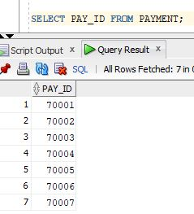
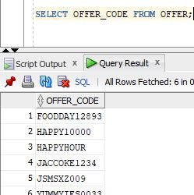
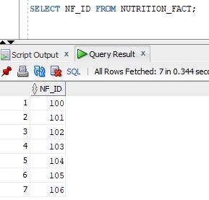

Slide 30
Select Query with where clause

Slide 31
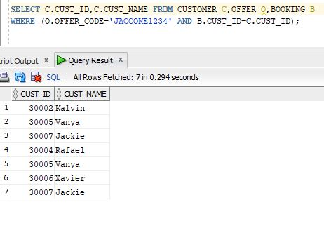
Listing all the Customers ID’s and Names who uses offer code ‘JACCOKE1234’

Slide 32
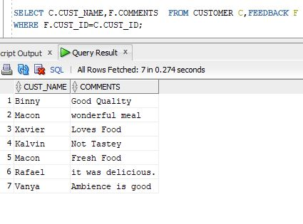
Listing all the Customer name along with their Comments to the Restaurant.

Slide 33
Group By

Slide 34
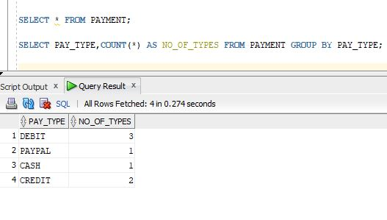
Show number of Payment_Types used by Customers.

Slide 35
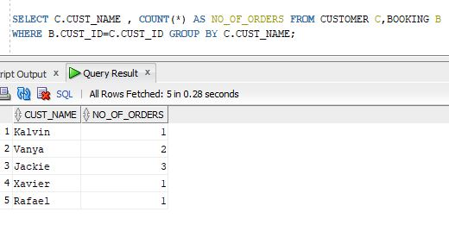
Show Number of Orders placed by each Customer

Slide 36
Having

Slide 37
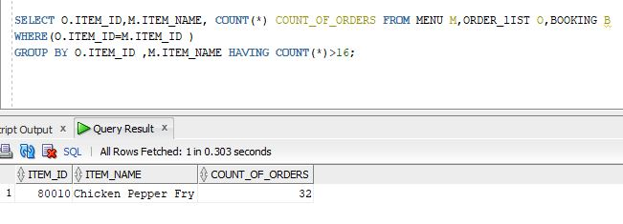
Showing Item_Id along with Item_Name with more than 16 orders to know the item which have placed more than 16 times.

Slide 38
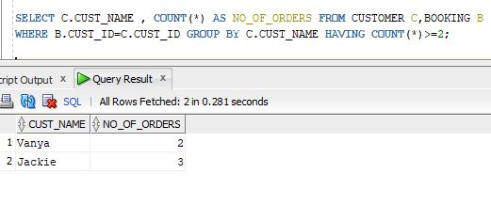
Listing Customers who have placed orders more than or equal to 2.

Slide 39
Inner Join

Slide 40
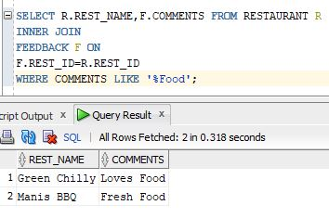
Showing all Restaurant Names who has comments which includes Food in it.

Slide 41
Left Outer Join

Slide 42
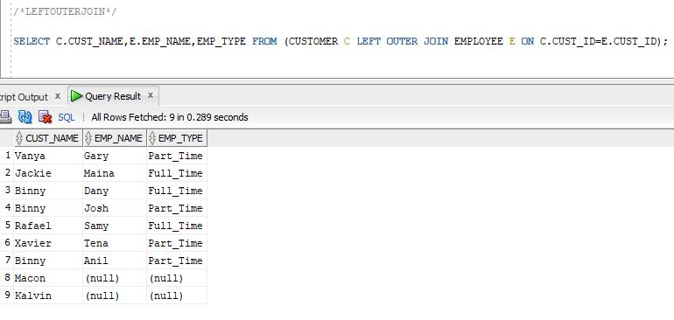
List all the Customers who received orders from Employees.

Slide 43
ORDER BY

Slide 44
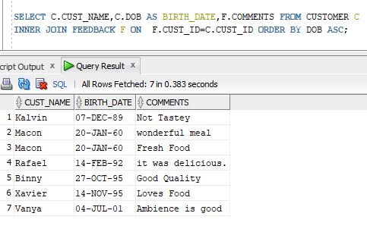
Listing all Customers name, Date of birth who have commented

Slide 45
Cascade

Slide 46
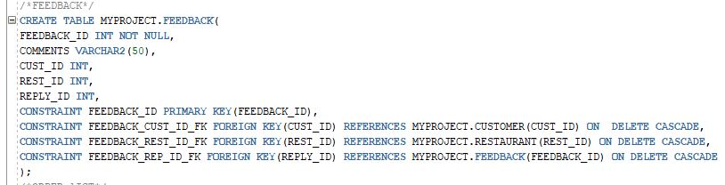
If Customer or Restaurant is deleted then the corresponding Feedback will get deleted

Slide 47
Union

Slide 48
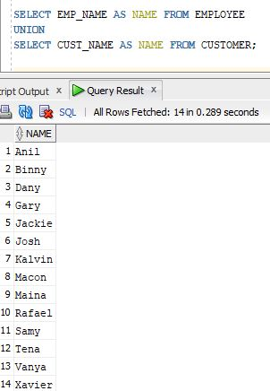
Get the name list of Employee and Customer

Slide 49
DATE

Slide 50
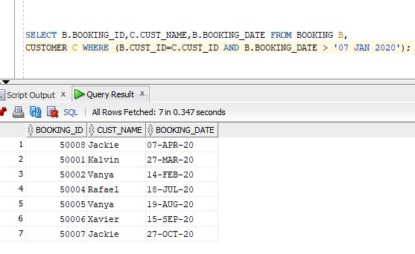
List all the Customers who Booked after 7th January 2020.

Slide 51
View

Slide 52
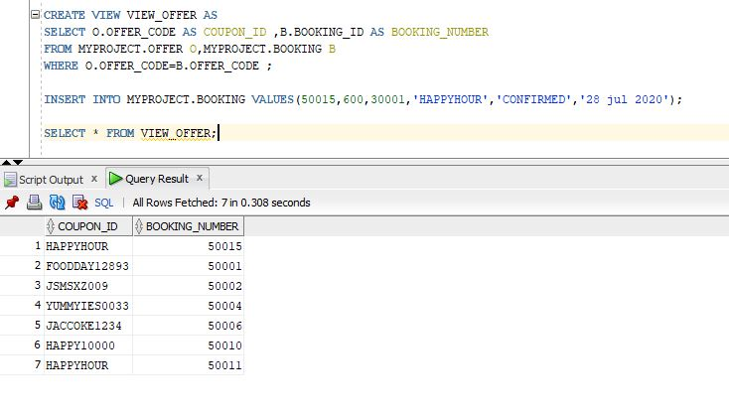
Demonstrate CREATE VIEW statement

Slide 53
Delete

Slide 54
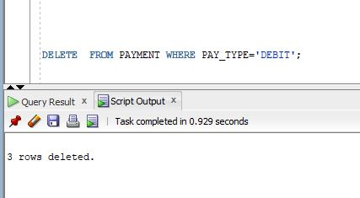
Delete three rows from a table

Slide 55
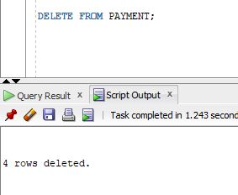
Delete all rows from a table, then delete the empty table from database

Slide 56
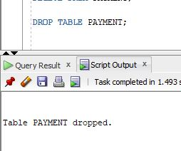
Delete the empty table from database

Slide 57
Thank You!

